Slide 1
Non-additive extreme effects of gene expression on anthropometric traits
Théo Dupuis
University of Dundee, School of Medicine
Population Health and Genomics

Slide 2
Disclosure
I am currently a full-time employee of Roche

Slide 3
Genetic effects on molecular traits
Hundreds to thousands of genetic variants associated with complex traits
> 90% of disease-associated variants in non-coding parts of the genome and of uncertain function
eQTL mapping to find genetic variants with effects on expression identity intermediate processes underlying the mechanism
Notes:
IRX3 -> ?

Slide 4
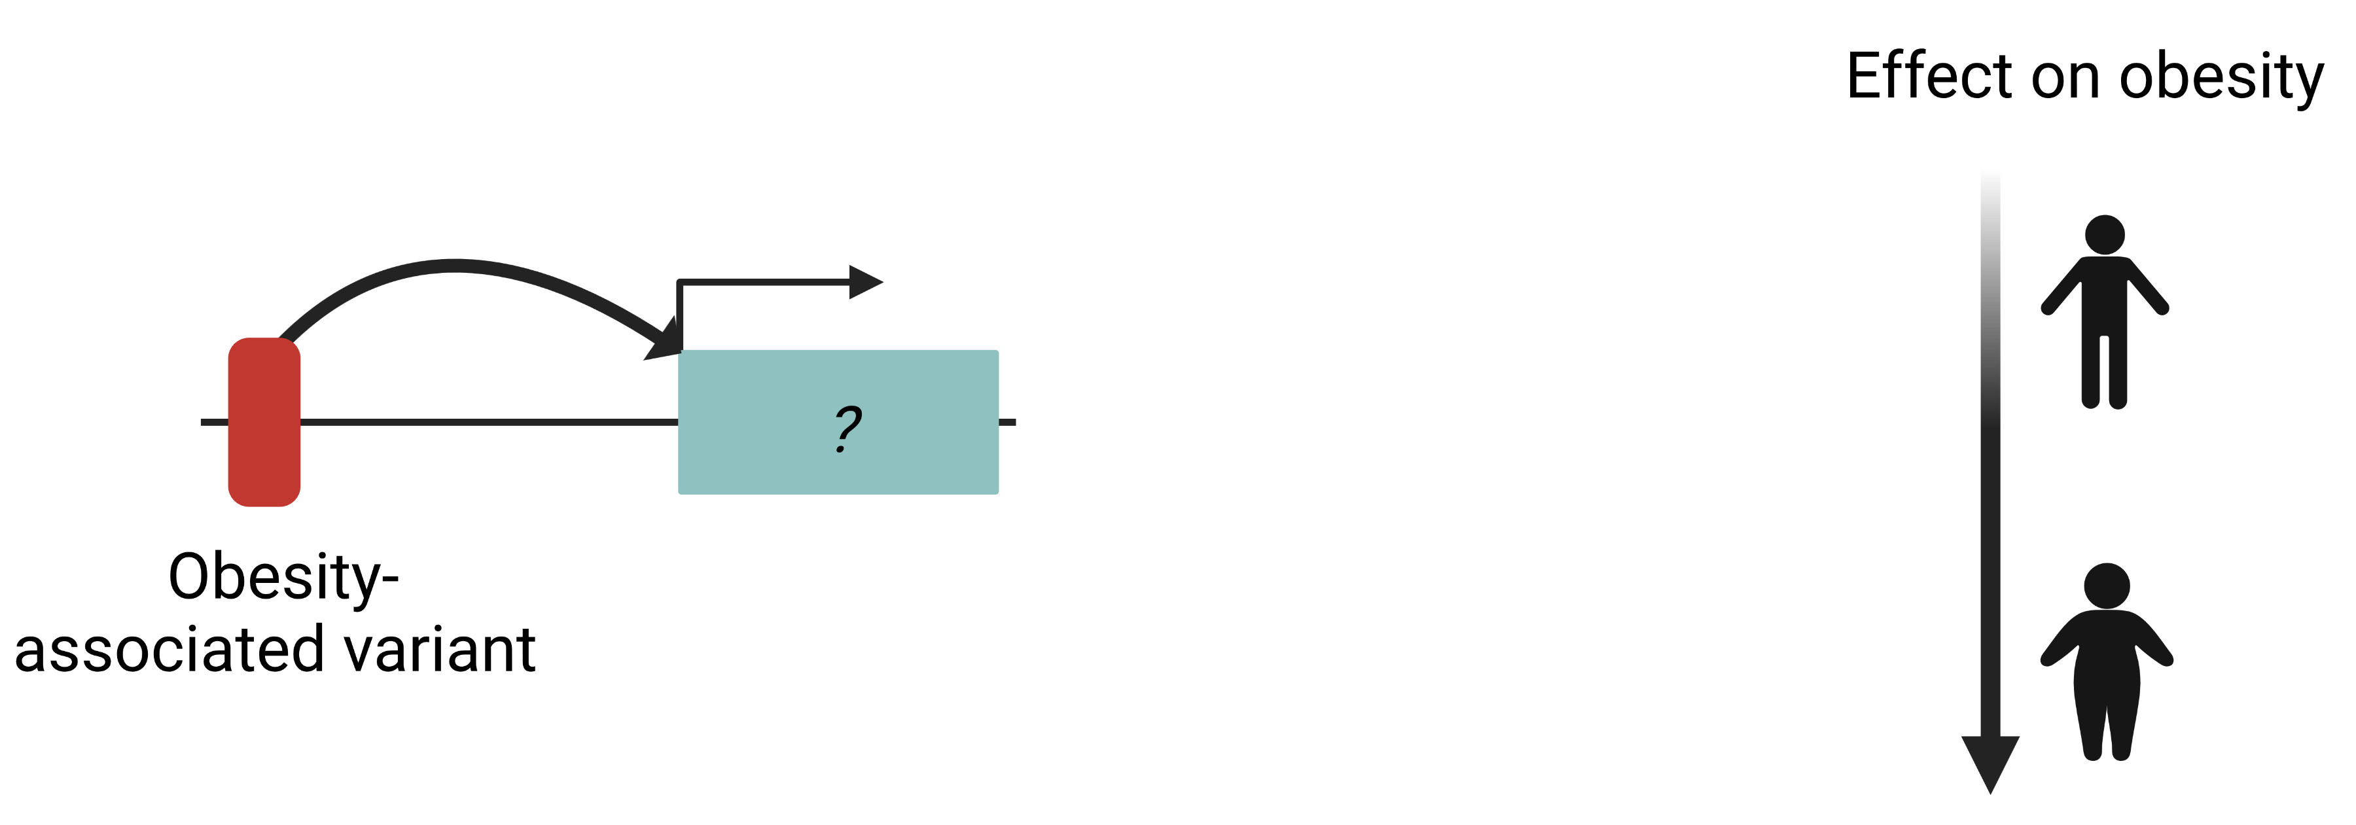
Genetic effects on molecular traits

Slide 5
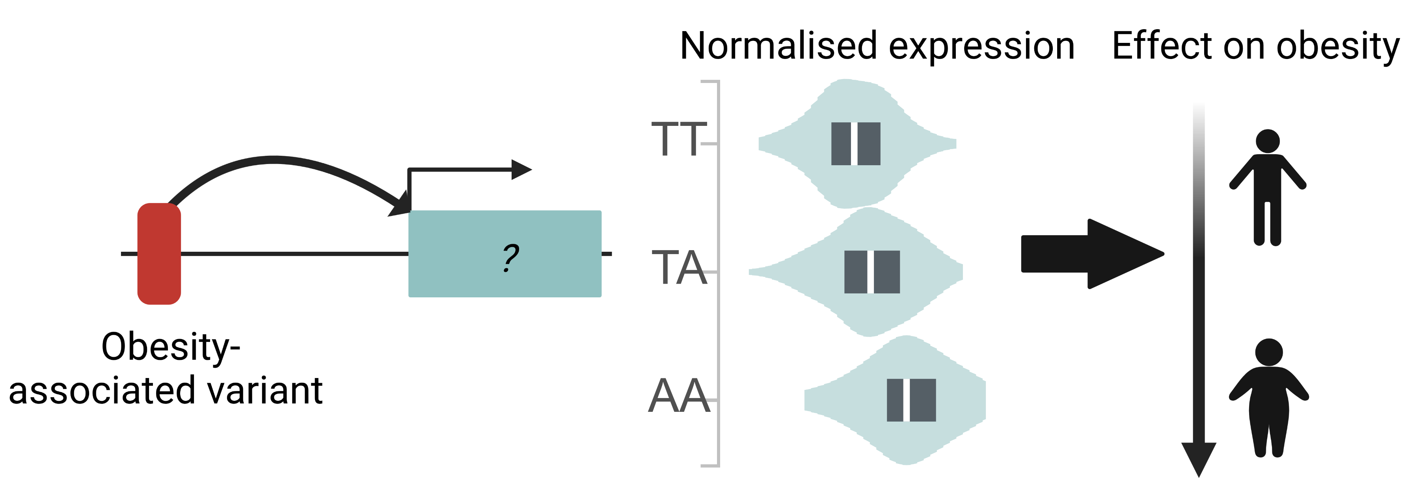
Genetic effects on molecular traits
*Adapted from GTEx portal

Slide 6
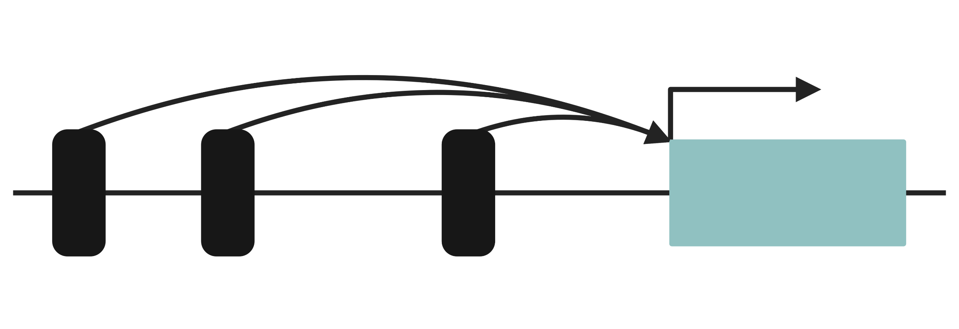
Many genes are regulated by multiple eQTLs
When multiple eQTLs regulate expression of a causal gene we expect their effect on disease risk to be consistent

Slide 7
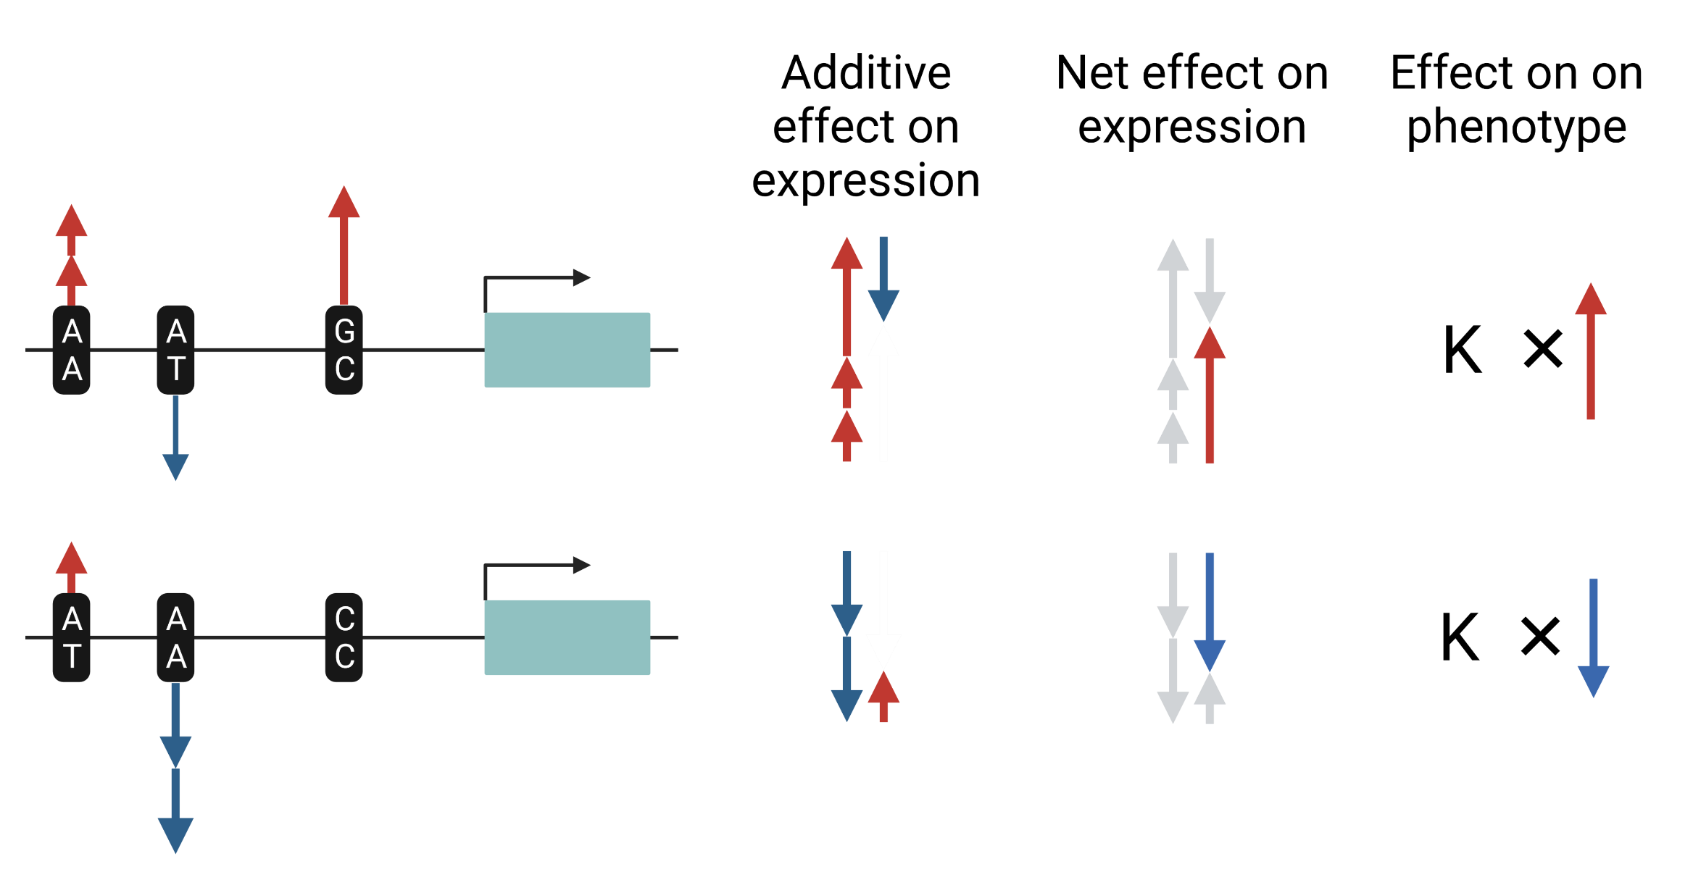
Additive genetic effects on gene expression

Slide 8
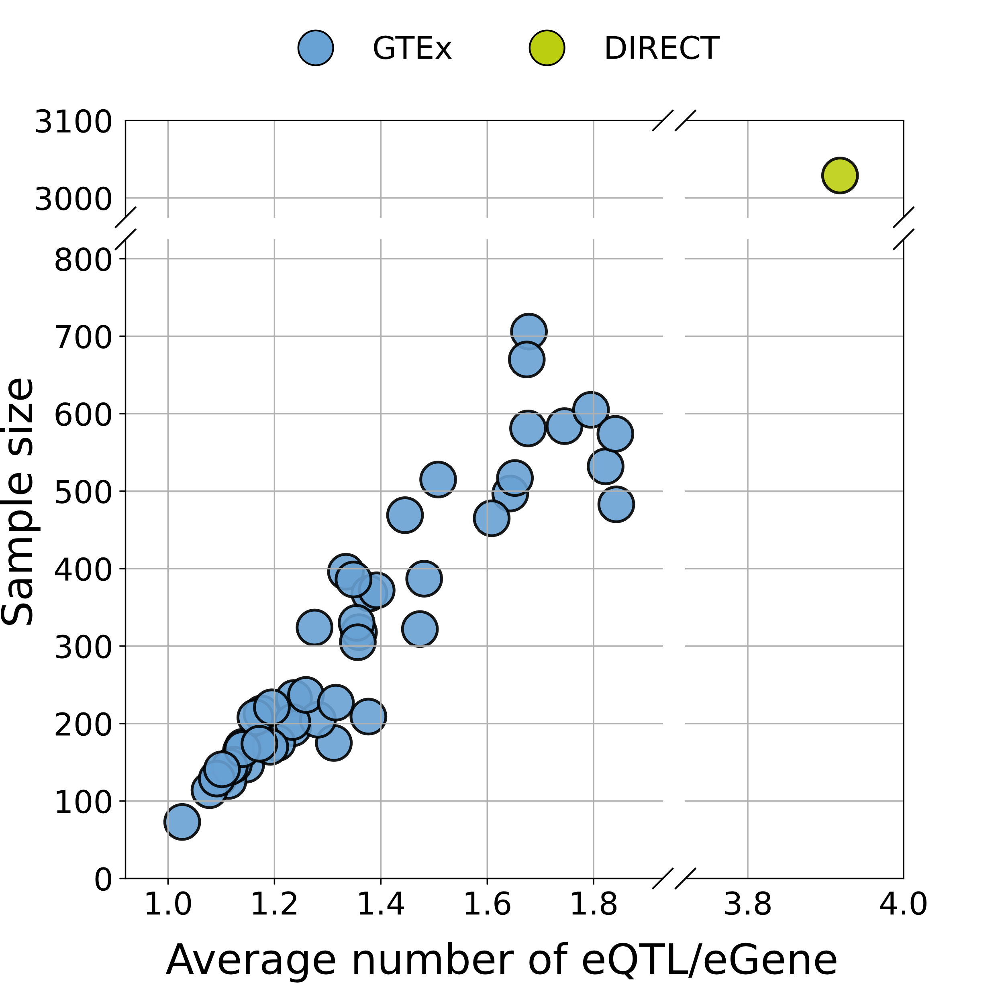
Multiple eQTLs help to find mediating genes
Methods using intermediate phenotypes to identify causal genes rely on this assumption of additive proportional effects (e.g. multi-instrument MR, TWAS)
In DIRECT (whole blood)¹
At least one significant genetic effect on expression in ~95% protein coding genes (i.e. eGenes)
2/3 of genes with 2+ eQTLs
^{1: Viñuela et al, 2021 medRxiv}

Slide 9
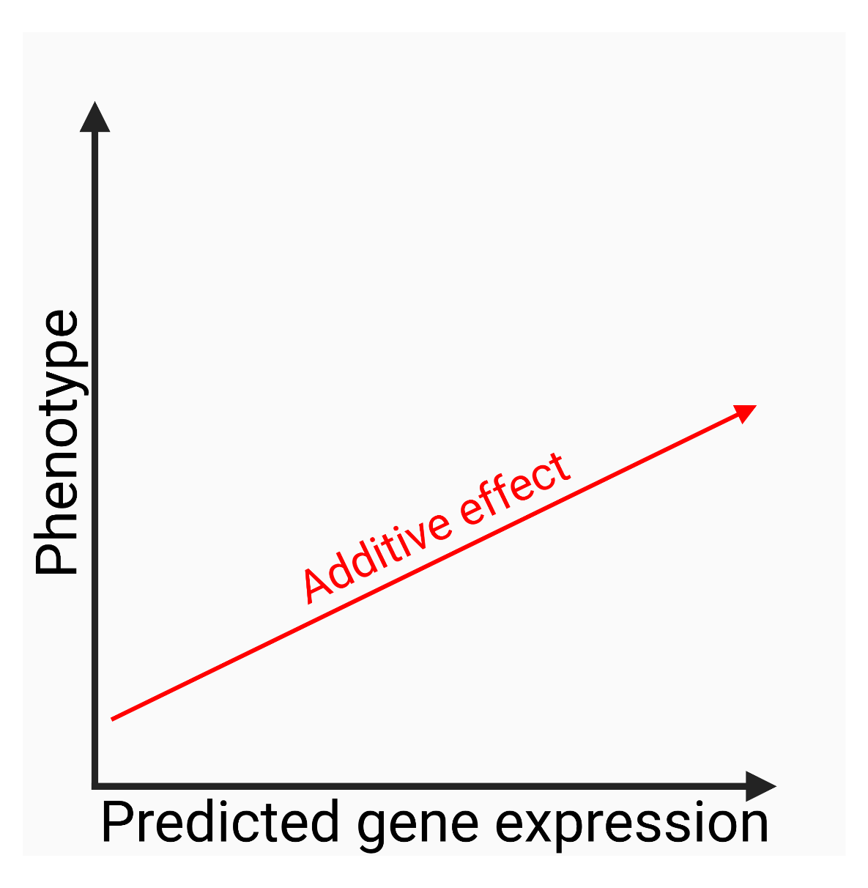
Additive genetic effects on gene expression (TWAS model)

Slide 10
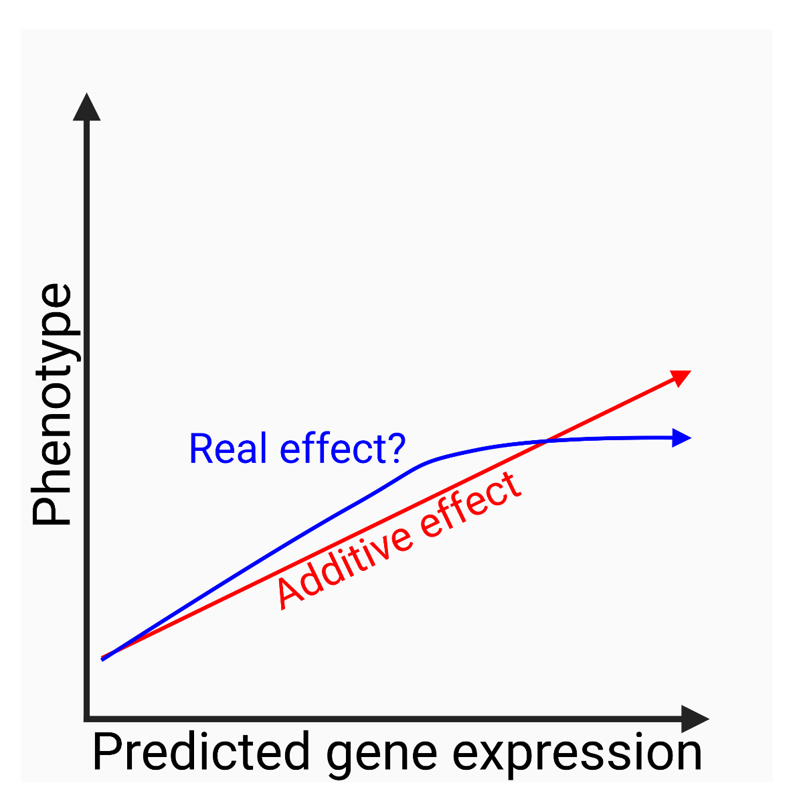
Additive models can miss the relation between expression and phenotype

Slide 11
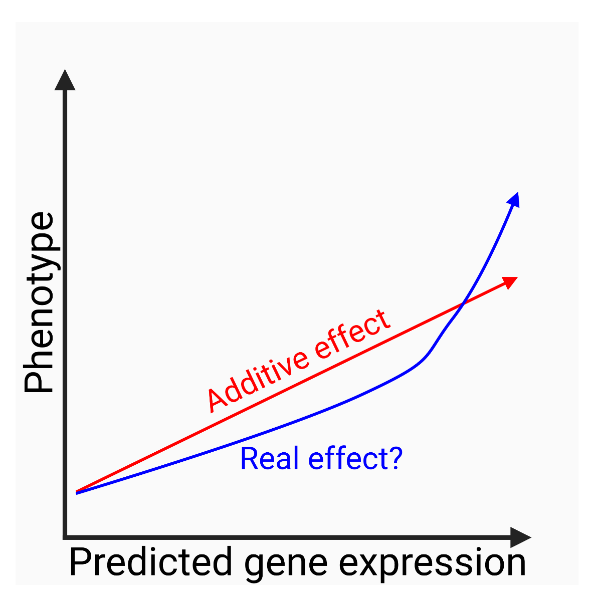
Additive models can miss the relation between expression and phenotype

Slide 12
Can we see additive genetic effects on gene expression resulting in non-additive consequences for phenotypes?

Slide 13
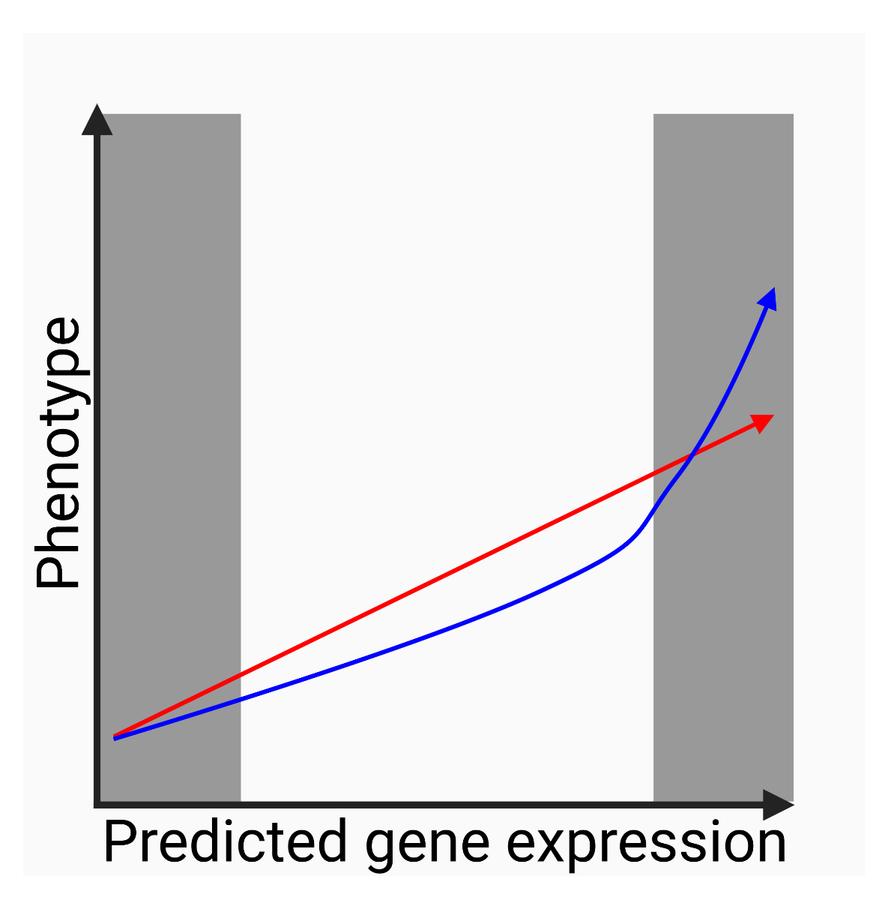
Deviations from the additive model for extreme expression

Slide 14


Data: independent eQTLs
 | (GTEx v8)
Independent eQTLs | ~499k | 59,971
Tissues | 44 tissues | Whole blood
Sample size | 73-706 (mean=323) | 3029
Number of gene-tissue pairs with 2+ eQTLs | ~109k | 12,824

Slide 15
Data: UK Biobank
Predicted expression in 45 tissues for 406k UK Biobank individuals

Slide 16
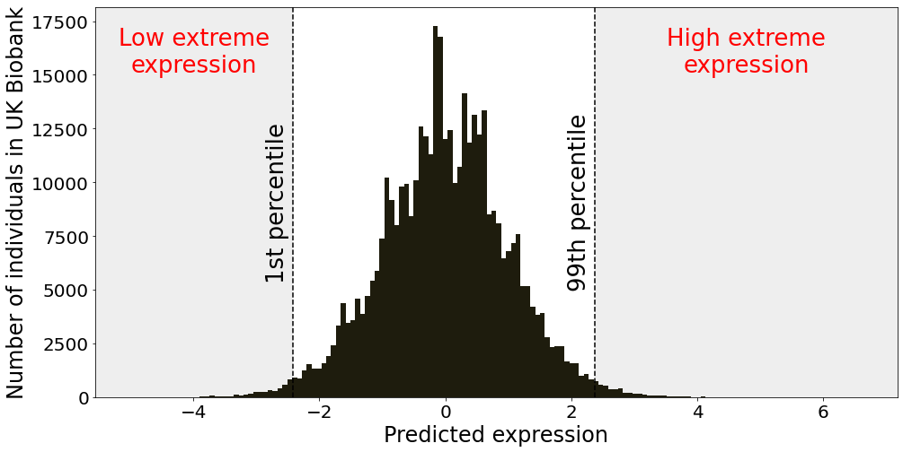
Genetically predicted extreme expression
For each gene-tissue pairs, individuals with predicted expression in top or bottom percentiles are considered to have extreme expression.

Slide 17

Testing the consequences of extreme expression
Additive model:
$${phenotype}^{∗}\sim predicted expression+{covariates}^{∗∗}$$
*: Blood pressure, BMI, grip strength, standing height, waist-hip ratio
**: age, sex, genotype PCs, other technical

Slide 18

Testing the consequences of extreme expression
Our model:
$${phenotype}^{∗}\sim predicted expression+extreme expression+{covariates}^{∗∗}$$
*: Blood pressure, BMI, grip strength, standing height, waist-hip ratio
**: age, sex, genotype PCs, other technical

Slide 19
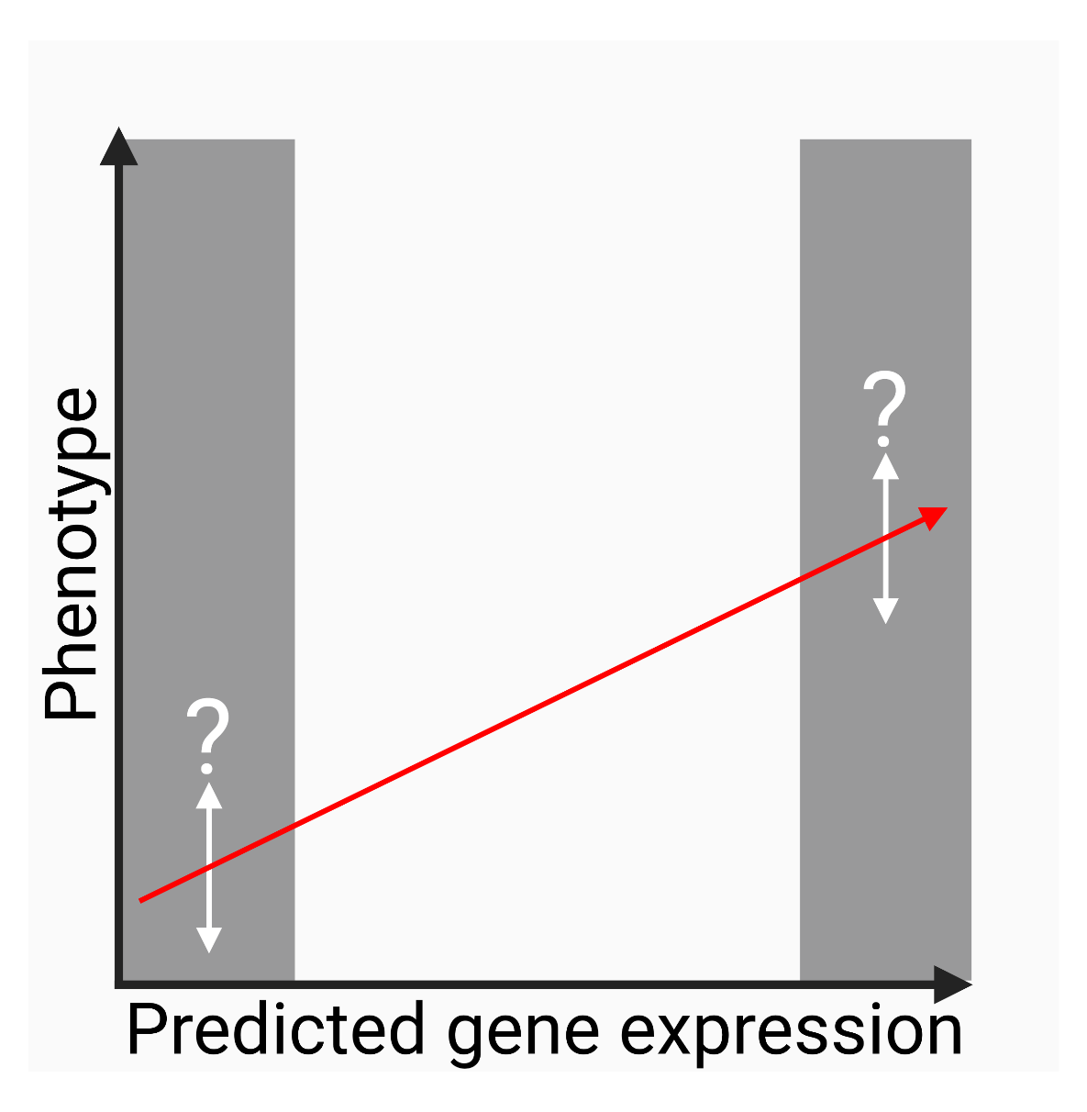
Deviations from the additive model for extreme expression

Slide 20
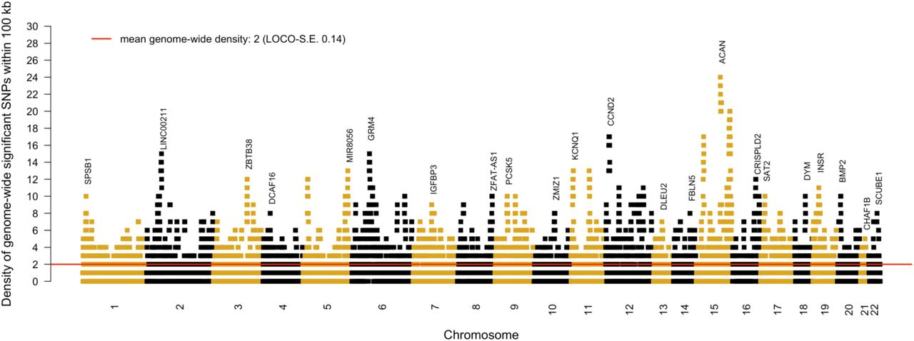
Examples of extreme expression effects on height
GWAS of height with 5.4M individuals. GIANT + 23andme. Yengo et al, BiorXiv 2022

Slide 21
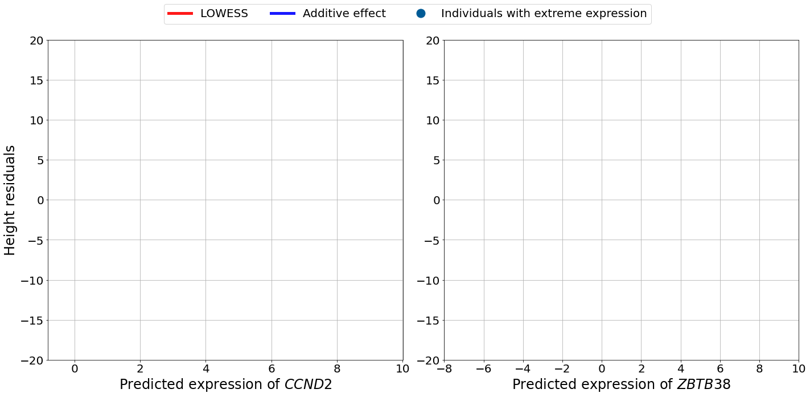
Examples of extreme expression effects

Slide 22
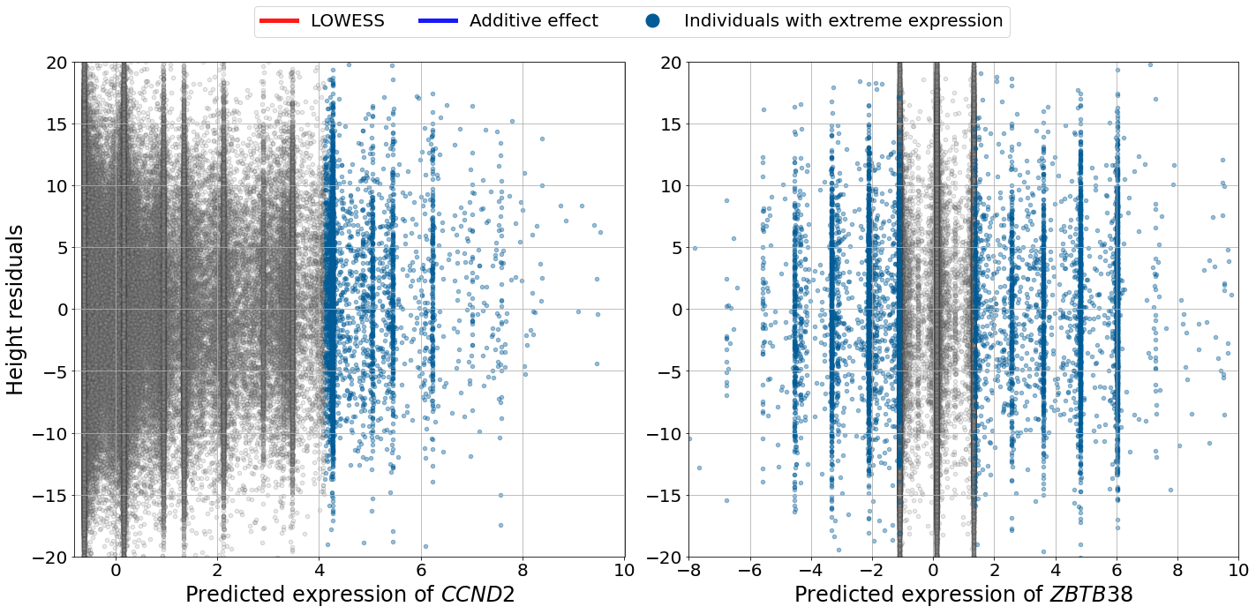
Examples of extreme expression effects

Slide 23
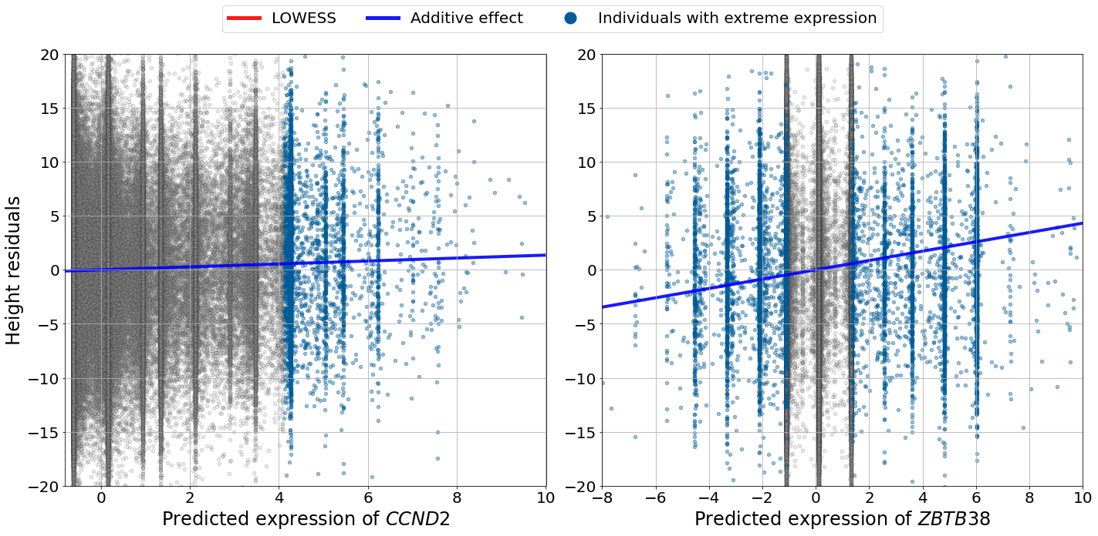
Examples of extreme expression effects

Slide 24
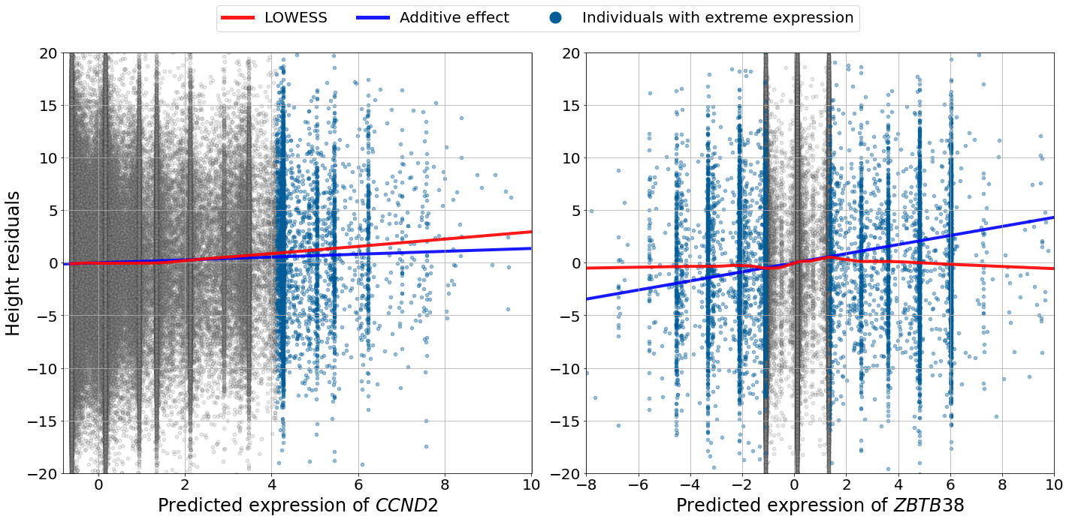
Examples of extreme expression effects

Slide 25
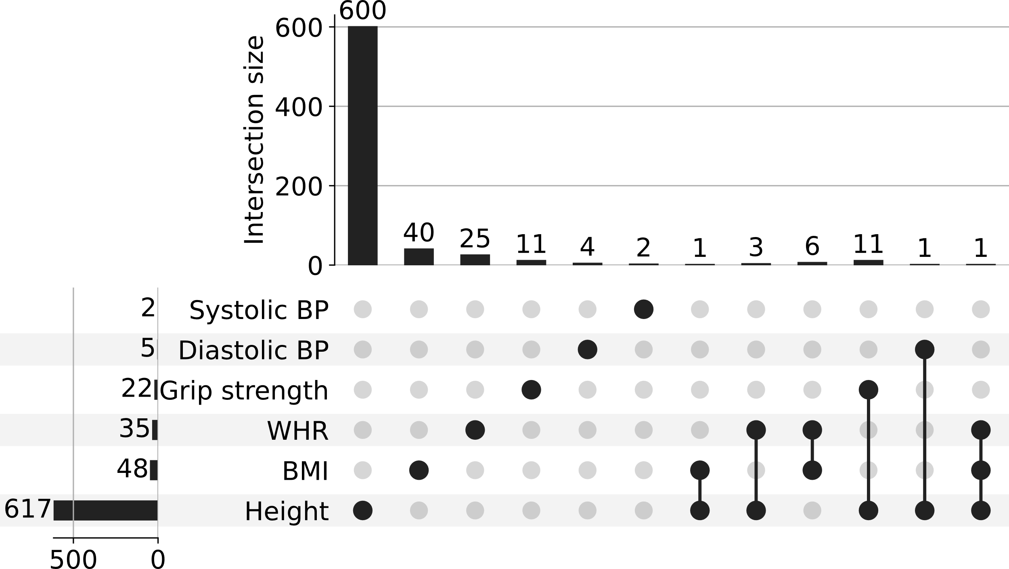
Polygenic traits show more non-additive effects
729 significant extreme effects on phenotype (qvalue < 5%)
In comparison almost 78k significant additive effect
609/729 additive effect significant as well
Most associations for height: more polygenic

Slide 26
Does extreme expression exacerbate or attenuate the additive effect?

Slide 27
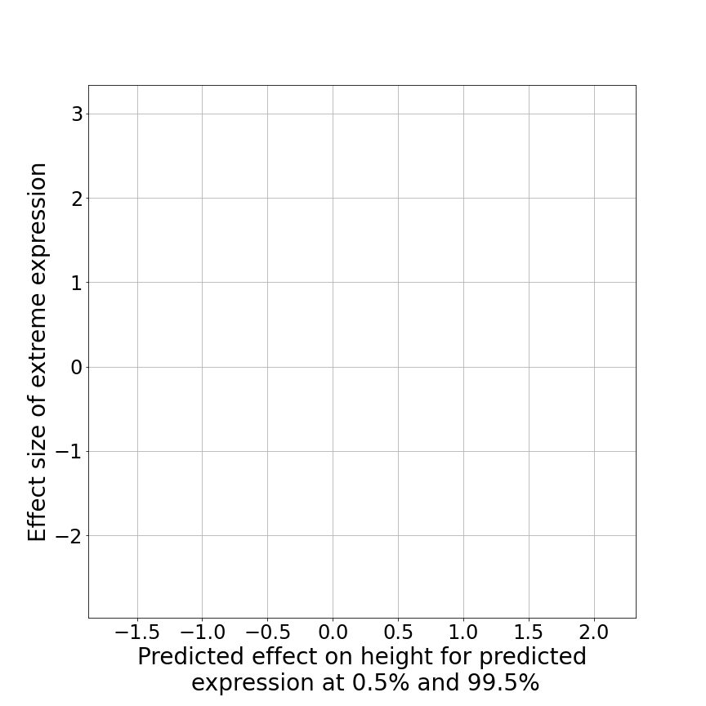
Comparison between the effect size of the extreme expression effect vs additive effect at the tails

Slide 28
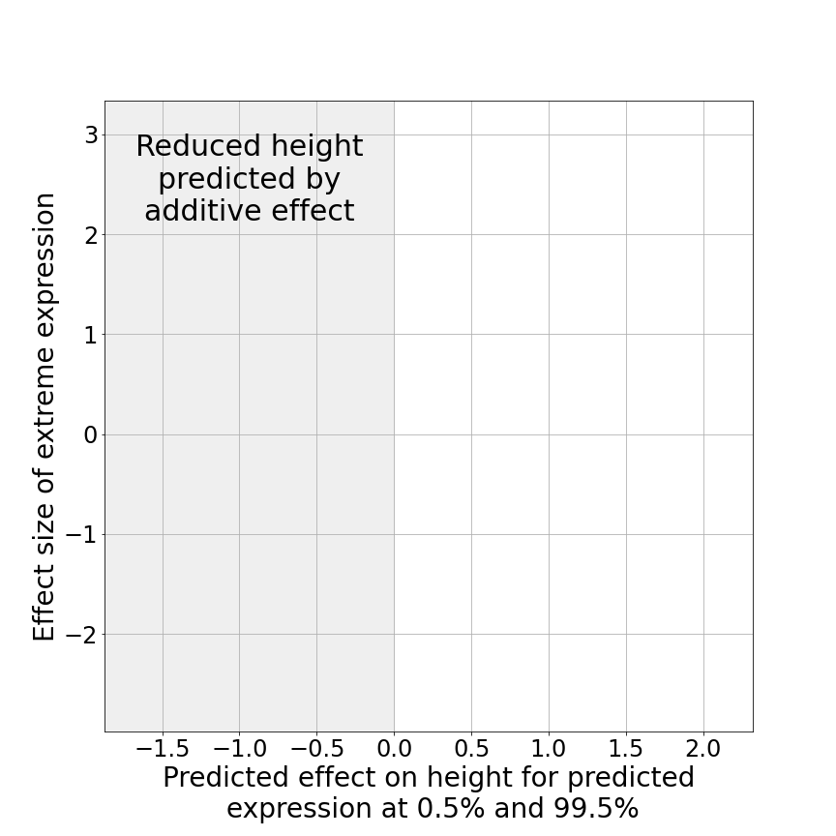
Comparison between the effect size of the extreme expression effect vs additive effect at the tails

Slide 29
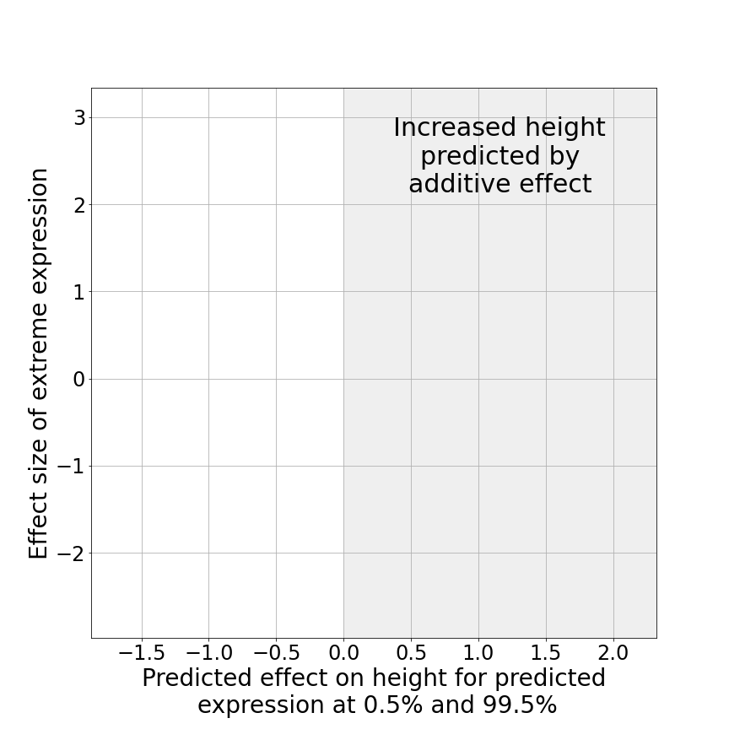
Comparison between the effect size of the extreme expression effect vs additive effect at the tails

Slide 30
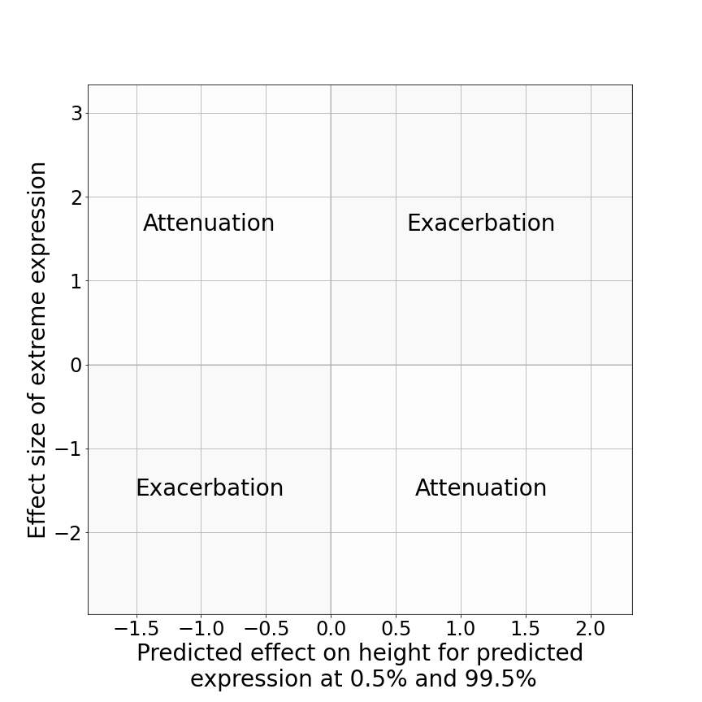
Comparison between the effect size of the extreme expression effect vs additive effect at the tails

Slide 31
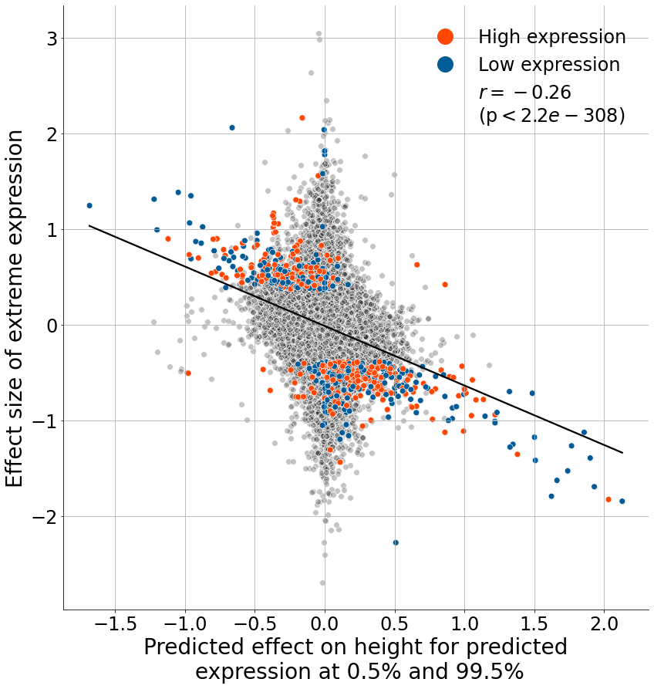
Comparison between the effect size of the extreme expression effect vs additive effect at the tails

Slide 32
Conclusion
Most models assume additive proportional effects on intermediate phenotype and whole-organism traits
We found that additive effect on expression may not always result in additive effects on phenotype
If confirmed, the frequent attenuation of gene expression effects on downstream phenotypes would highlight how epistasis is not always caused by a physical interaction between gene products but by any process resulting in non-additive consequences

Slide 33



Acknowledgements
Human Omics in Dundee and Newcastle
University of Dundee
Andrew Brown
David Davtian
Ewan Pearson
Moneeza Siddiqui
University of Geneva
Ambra Sartori
Aline Real Emmanouil Dermitzakis
Newcastle University
Ana Viñuela
Registration to ESHG funded by the
Leng Trust scholarship
Some figures created with Biorender
2395453@dundee.ac.uk
@Theodysse

Slide 34
Additional slides

Slide 35

Predicted expression
$$Predicted expression \left(G, T,I\right)=\sum_{k=1}^{{Number of eQTLs}_{G,T}}{{dosage}_{I,k} ×{effect size}_{k}}$$
G = gene, T = tissue, I = individual

Slide 36
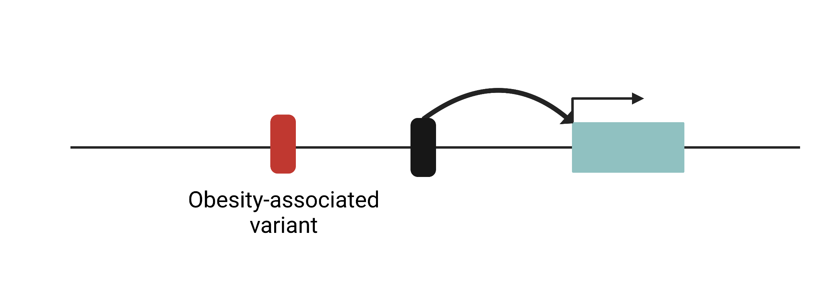
Caveats: linkage disequilibrium

Slide 37
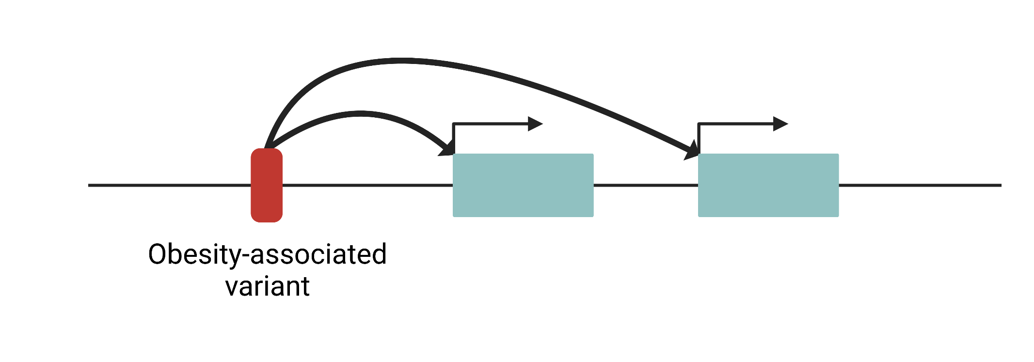
Caveats: pleiotropy

